Slide 1
PH101: PHYSICS1
Lecture 3

Slide 2




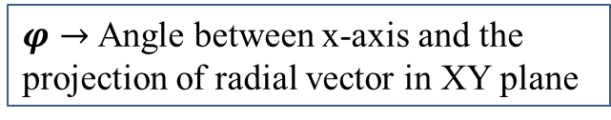









Spherical polar coordinate system
$$Z$$
$r→$ Radial distance from origin
$θ→$ Angle of radial vector with $z$-axis.
$$(x,y,z)$$
$$θ$$
$φ→$Angle between x-axis and the projection of radial vector in XY plane
$$r$$
$$Y$$
$$φ$$
$\left(r,θ,φ\right)$ is known as spherical polar coordinate
$$X$$
Note that point $(r,θ,φ)$ is at the intersection of three surfaces
A sphere where $r=$ Constant
Be careful, notations are different.
$r$ and $θ$ are not planer coordinate.
A cone about $z$ = axis with $θ$= constant.
A half plane containing $z$-axis and $φ$= constant

Slide 3







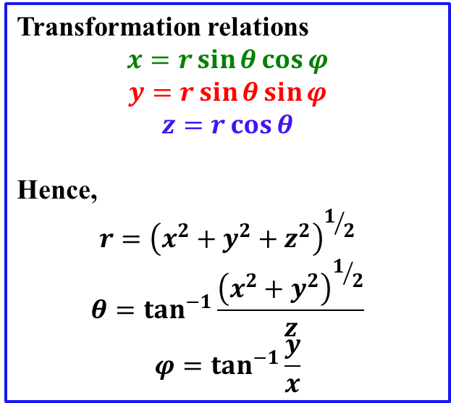





Connection of spherical polar with Cartesian
$$Z$$
Transformation relations
$$x=r\sin{θ}\cos{φ}$$
$$y=r\sin{θ}\sin{φ}$$
$$z=r\cos{θ}$$
Hence,
$$r={\left(x^{2}+y^{2}+z^{2}\right)}^{1/2}$$
$$θ=\tan^{−1}{\frac{{\left(x^{2}+y^{2}\right)}^{1/2}}{z}}$$
$$φ=\tan^{−1}{\frac{y}{x}}$$
$$(x,y,z)$$
$$r\cos{θ}$$
$$θ$$
$$r\sin{θ}$$
$$r\cos{θ}$$
$$r$$
$$Y$$
$$φ$$
$$r\sin{θ}\cos{φ}$$
$$r\sin{θ}\sin{φ}$$
$$X$$

Slide 4
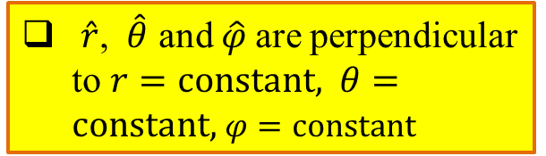
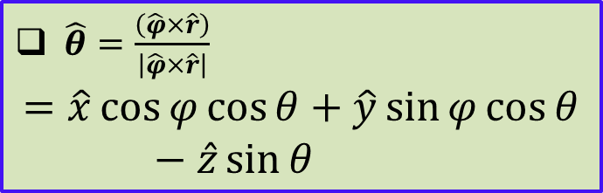
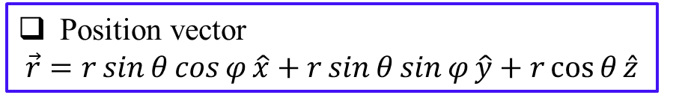

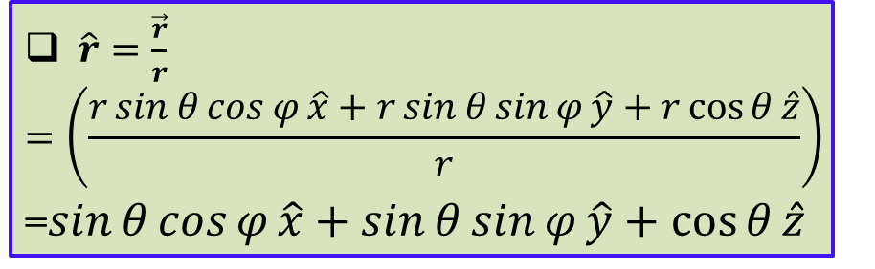

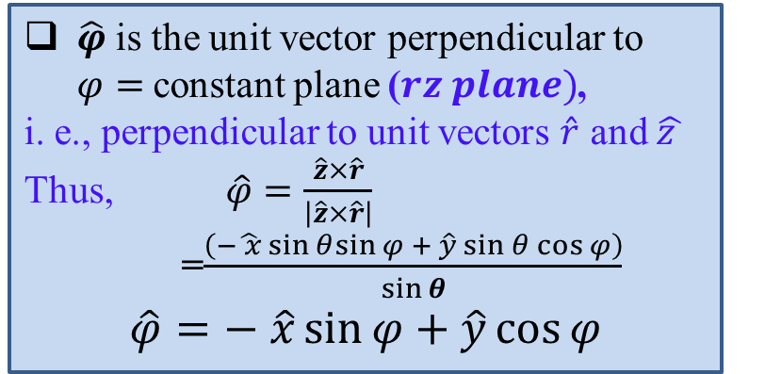

Unit vectors in spherical polar
$$Z$$
Position vector
$$\vec{r}=r\sin{θ}\cos{φ}\hat{x}+r\sin{θ}\sin{φ}\hat{y}+r\cos{θ}\hat{z}$$
$$θ$$
$$(x,y,z)$$
$\hat{r}=\frac{\vec{r}}{r}$
$$=\left(\frac{r\sin{θ}\cos{φ}\hat{x}+r\sin{θ}\sin{φ}\hat{y}+r\cos{θ}\hat{z}}{r}\right)$$
=$\sin{θ}\cos{φ}\hat{x}+\sin{θ}\sin{φ}\hat{y}+\cos{θ}\hat{z}$
$$r$$
$$Y$$
$$φ$$
$$X$$
$\hat{r}$, $\hat{θ}$ and $\hat{φ}$are perpendicular to $r=constant,$ $θ=constant,$ $φ=constant$
$\hat{φ}$ is the unit vector perpendicular to $φ=$constant plane ($rz plane)$,
i. e., perpendicular to unit vectors $\hat{r}$ and $\hat{z }$
Thus, $\hat{φ}=\frac{\hat{z}×\hat{r}}{\left|\hat{z}×\hat{r}\right|}$
=$\frac{\left(−\hat{ x}\sin{θ}sin{φ} + \hat{y}\sin{θ}\cos{φ}\right)}{\sin{θ}}$
$$\hat{φ}=− \hat{x}\sin{φ}+\hat{y}\cos{φ}$$
$\hat{θ}=\frac{\left(\hat{φ}×\hat{r}\right)}{\left|\hat{φ}×\hat{r}\right|}$
$$=\hat{x}\cos{φ}cos{θ}+\hat{y}\sin{φ\cos{θ}}−\hat{z}\sin{θ}$$

Slide 5





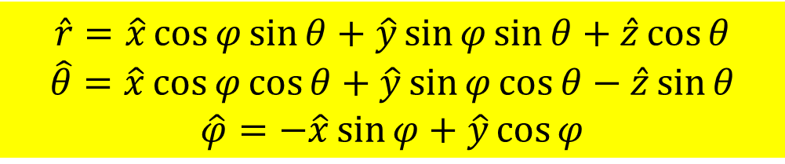





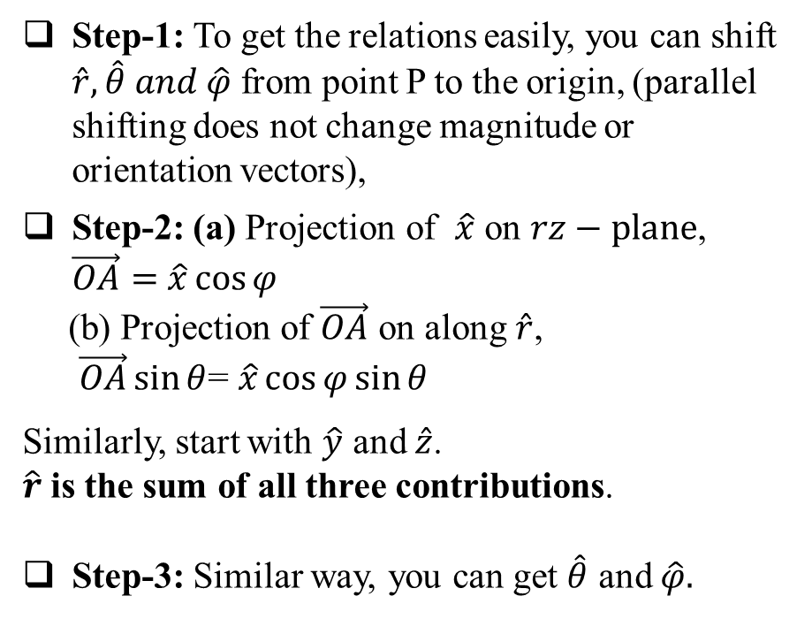
Another way of getting the unit vectors
$$Z$$
Step-1: To get the relations easily, you can shift $\hat{r},\hat{θ} and \hat{φ}$ from point P to the origin, (parallel shifting does not change magnitude or orientation vectors),
Step-2: (a) Projection of $\hat{x}$ on $rz−plane$, $\vec{OA}=$ $\hat{x}\cos{φ}$
(b) Projection of $\vec{OA}$ on along$\hat{r}$,
$\vec{OA}\sin{θ}$= $\hat{x}\cos{φ}\sin{θ}$
Similarly, start with $\hat{y}$ and $\hat{z}$.
$\hat{r}$ is the sum of all three contributions.
Step-3: Similar way, you can get $\hat{θ}$ and $\hat{φ}.$
$\hat{r}$
$$\hat{φ}$$
$$\hat{z}$$
$$r$$
$$θ$$
$\hat{θ}$
O
A
$$\hat{x}$$
$$φ$$
$$X$$
$$\hat{r}=\hat{x}\cos{φ}sin{θ}+\hat{y}\sin{φ}sin{θ}+\hat{z}\cos{θ}$$
$$\hat{θ}=\hat{x}\cos{φ}cos{θ}+\hat{y}\sin{φ\cos{θ}}−\hat{z}\sin{θ}$$
$$\hat{φ}=−\hat{x}\sin{φ}+\hat{y}\cos{φ}$$

Slide 6
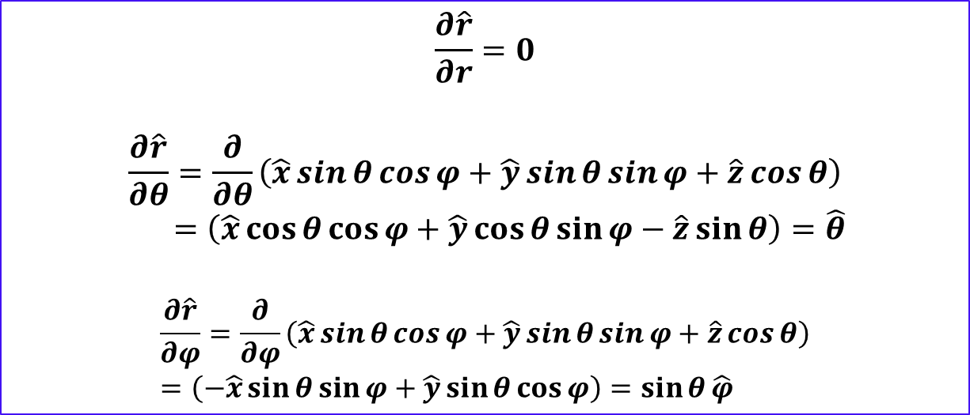
Partial differential of unit vectors in spherical polar
Unit vectors in spherical polar coordinate are function of $θ$ and $φ$ only.
$$\frac{∂\hat{r}}{∂r}=0$$
$$\frac{∂\hat{r}}{∂θ}=\frac{∂}{∂θ}\left(\hat{x}\sin{θ}\cos{φ}+\hat{y}\sin{θ}\sin{φ}+\hat{z}\cos{θ}\right)$$
$=\left(\hat{x}\cos{θ}\cos{φ}+\hat{y}\cos{θ\sin{φ−\hat{z}\sin{θ}}}\right)=\hat{θ}$
$$\frac{∂\hat{r}}{∂φ}=\frac{∂}{∂φ}\left(\hat{x}\sin{θ}\cos{φ}+\hat{y}\sin{θ}\sin{φ}+\hat{z}\cos{θ}\right)=\left(−\hat{x}\sin{θ}\sin{φ}+\hat{y}\sin{θ}{\cos{φ}}\right)=\sin{θ}\hat{φ}$$

Slide 7
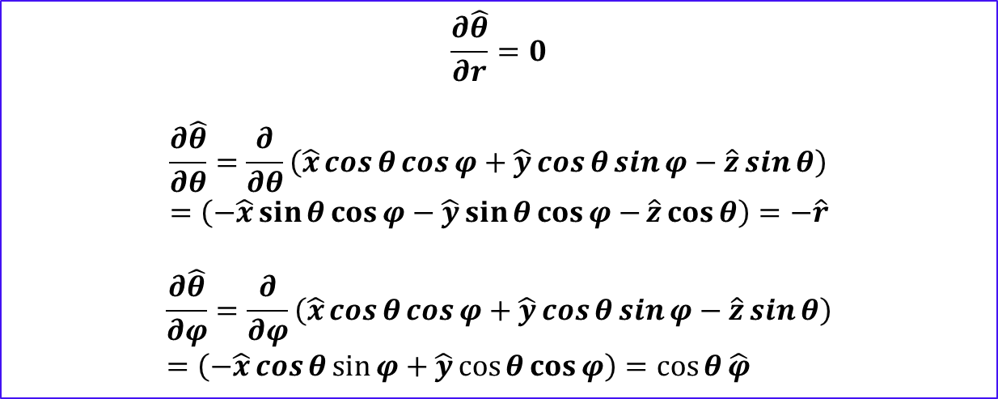
Partial differential of unit vectors in spherical polar
Unit vectors in spherical polar coordinate are function of $θ$ and $φ$ only.
$$\frac{∂\hat{θ}}{∂r}=0$$
$$\frac{∂\hat{θ}}{∂θ}=\frac{∂}{∂θ}\left(\hat{x}\cos{θ}\cos{φ}+\hat{y}\cos{θ\sin{φ−\hat{z}\sin{θ}}}\right)=\left(−\hat{x}\sin{θ}\cos{φ}−\hat{y}\sin{θ}{\cos{φ}−}\hat{z}\cos{θ}\right)=−\hat{r}$$
$$\frac{∂\hat{θ}}{∂φ}=\frac{∂}{∂φ}\left(\hat{x}\cos{θ}\cos{φ}+\hat{y}\cos{θ\sin{φ−\hat{z}\sin{θ}}}\right)=\left(−\hat{x}\cos{θ}\sin{φ}+\hat{y}\cos{θ}{\cos{φ}}\right)=\cos{θ}\hat{φ}$$

Slide 8
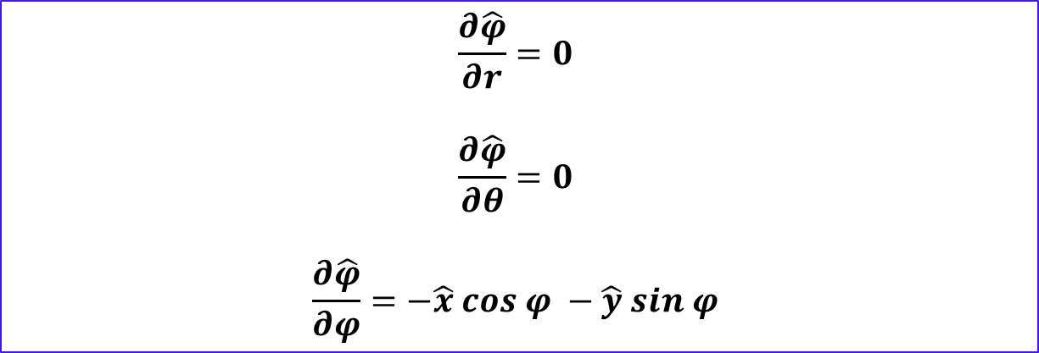
Partial differential of unit vectors in spherical polar
Unit vectors in spherical polar coordinate are function of $θ$ and $φ$ only.
$$\frac{∂\hat{φ}}{∂r}=0$$
$$\frac{∂\hat{φ}}{∂θ}=0$$
$$\frac{∂\hat{φ}}{∂φ}=−\hat{x} cos φ −\hat{y} sin φ$$

Slide 9

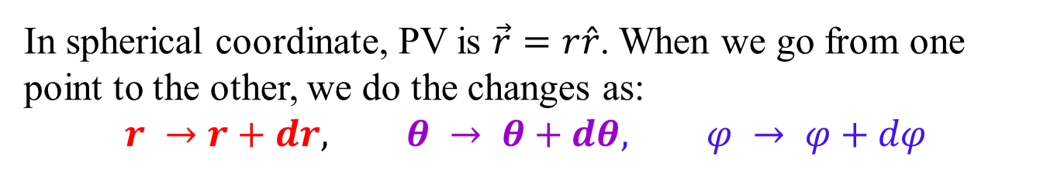
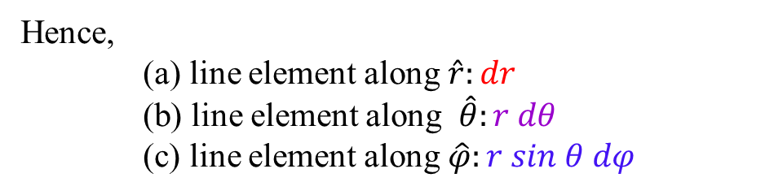
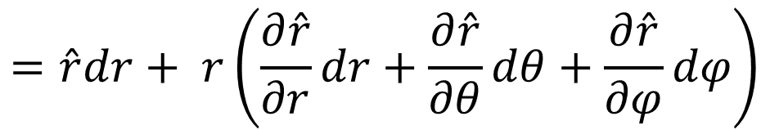
Path increment in spherical polar coord.
In spherical coordinate, PV is $\vec{r}=r\hat{r}$. When we go from one point to the other, we do the changes as:
$$r →r+dr, θ → θ+dθ, φ → φ+dφ$$
Path increment (line element) $d\vec{r}$ in spherical coordinates:
$$d\vec{r}=d\left(r\hat{r}\right)=\hat{r}dr+ rd\hat{r}$$
$$=\hat{r}dr+ r\left(\frac{∂\hat{r}}{∂r}dr+\frac{∂\hat{r}}{∂θ}dθ+\frac{∂\hat{r}}{∂φ}dφ\right)$$
$$=\hat{r }dr+ \hat{θ} rdθ+\hat{φ} r sin θ dφ$$
Hence,
(a) line element along $\hat{r}:dr$
(b) line element along $\hat{θ}:r dθ$
(c) line element along $\hat{φ}:r sin θ dφ$

Slide 10


















Path increment in spherical polar coord.
$$Z$$
$$r\sin{θ}$$
$r\sin{θ}dφ \hat{φ}$
$$dr\hat{r}$$
$$rdθ\hat{θ}$$
$r\sin{θ}dφ \hat{φ}$
$$dφ$$
($r,θ,φ$)
$$d\vec{r}$$
$$θ$$
$$r$$
$$\vec{r}+d\vec{r}$$
$$rdθ\hat{θ}$$
$$dθ$$
$$Y$$
$$φ$$
$$X$$
$$d\vec{r}=dr\hat{r}+rdθ\hat{θ}+r\sin{θ}dφ \hat{φ}$$

Slide 11

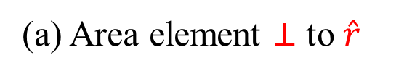
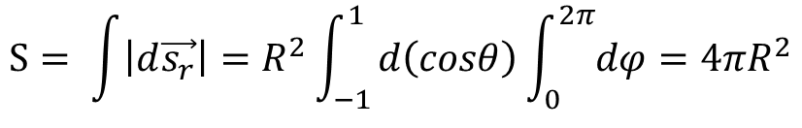
Surface elements in spherical polar coord.
Three possibilities of surface area elements ($d\vec{s}$):
(a) $d\vec{s}⊥ \hat{r}$ (b) $d\vec{s}⊥\hat{θ}$ (c)$d\vec{s}⊥ \hat{φ}$
(a) Area element $⊥$ to $\hat{r}$
$$d\vec{s_{r}}=r dθ r sinθ dφ \hat{r}=r^{2}sinθ dθ dφ \hat{r}, 0≤ θ ≤ π and 0≤φ ≤2π$$
$$=r^{2} d\left(cosθ\right) dφ; −1≤cosθ ≤1$$
Very easy to see that this is correct as the total area of a sphere is given by:
$$S= \int{\left|d\vec{s_{r}}\right|=R^{2}\int_{−1}^{1}{d\left(cosθ\right)\int_{0}^{2π}{dφ}=4πR^{2}}}$$
Notes:
Draw area elements using Note

Slide 12


Surface elements in spherical polar coord.
Three possibilities of surface area elements ($d\vec{s}$):
(a) $d\vec{s}⊥ \hat{r}$ (b) $d\vec{s}⊥\hat{θ}$ (c)$d\vec{s}⊥ \hat{φ}$
(b) Area element $⊥$ to $\hat{θ}$: Distances are covered in $\hat{r} and \hat{φ}$ directions
$$d\vec{s_{θ}}=dr r sinθ dφ \hat{θ}=r sinθ dr dφ \hat{θ}$$
(c) Area element $⊥$ to $\hat{φ}$: Distances are covered in $\hat{r} and \hat{θ}$ directions
$$d\vec{s_{φ}}=dr r dθ \hat{φ}=r dr dθ \hat{φ}$$
Notes:
Draw area elements using Note

Slide 13
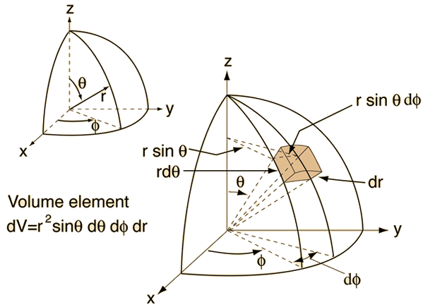
Volume element in spherical polar coord.
Volume element: Distances are covered in $\hat{r}, \hat{θ} and \hat{φ}$ directions
$$dV=dr. rdθ. r sinθ dφ=r^{2} sinθ dr dθ dφ= r^{2} d\left(cosθ\right) dr dφ$$
Notes:
Draw area elements using Note

Slide 14
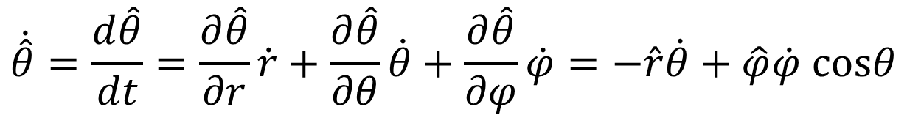
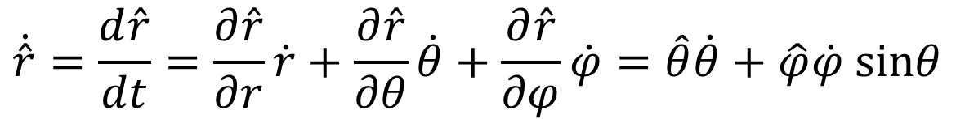
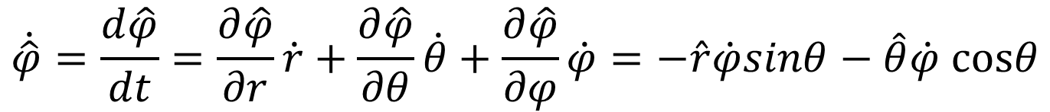
Time derivatives of unit vectors
Time derivatives of unit vectors in spherical coordinates:
$$\dot{\hat{r}}=\frac{d\hat{r}}{dt}=\frac{∂\hat{r}}{∂r}\dot{r}+\frac{∂\hat{r}}{∂θ}\dot{θ}+\frac{∂\hat{r}}{∂φ}\dot{φ}=\hat{θ}\dot{θ}+\hat{φ}\dot{φ} sinθ$$
$$\dot{\hat{θ}}=\frac{d\hat{θ}}{dt}=\frac{∂\hat{θ}}{∂r}\dot{r}+\frac{∂\hat{θ}}{∂θ}\dot{θ}+\frac{∂\hat{θ}}{∂φ}\dot{φ}=−\hat{r}\dot{θ}+\hat{φ}\dot{φ} cosθ$$
$$\dot{\hat{φ}}=\frac{d\hat{φ}}{dt}=\frac{∂\hat{φ}}{∂r}\dot{r}+\frac{∂\hat{φ}}{∂θ}\dot{θ}+\frac{∂\hat{φ}}{∂φ}\dot{φ}=−\hat{r}\dot{φ}sinθ−\hat{θ}\dot{φ} cosθ$$

Slide 15
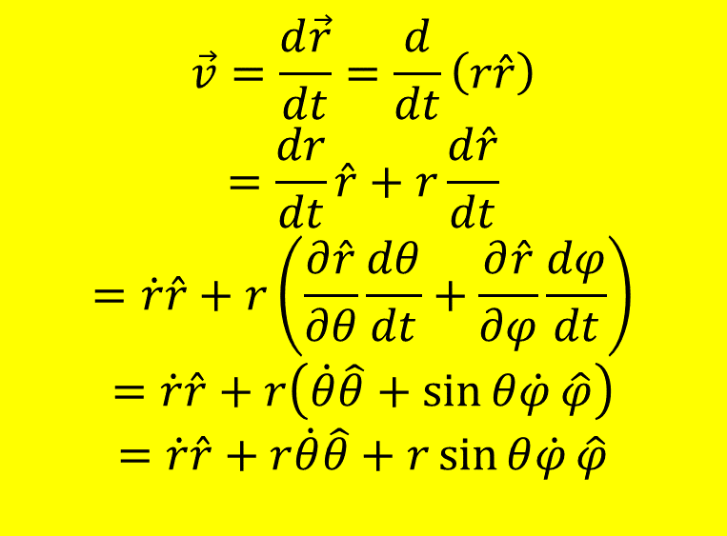
Velocity in spherical polar coordinate
$$\vec{v}=\frac{d\vec{r}}{dt}=\frac{d}{dt}\left(r\hat{r}\right)$$
$$=\frac{dr}{dt}\hat{r}+r\frac{d\hat{r}}{dt}$$
$$=\dot{r}\hat{r}+r\left(\frac{∂\hat{r}}{∂θ}\frac{dθ}{dt}+\frac{∂\hat{r}}{∂φ}\frac{dφ}{dt}\right)$$
$$=\dot{r}\hat{r}+r\left(\dot{θ}\hat{θ}+\sin{θ\dot{φ}}\hat{φ}\right)$$
$$=\dot{r}\hat{r}+r\dot{θ}\hat{θ}+r\sin{θ\dot{φ}}\hat{φ}$$
Chain rule

Slide 16
Acceleration in spherical polar coordinate

Slide 17
Acceleration in spherical polar coordinate

Slide 18
Acceleration in spherical polar coordinate

Slide 19
Acceleration in spherical polar coordinate

Slide 20


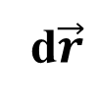
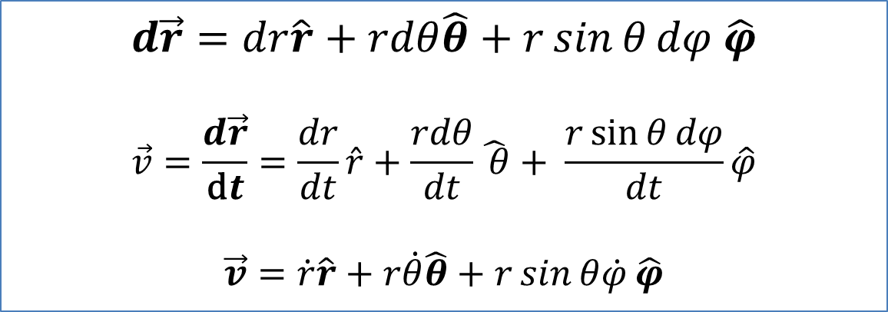




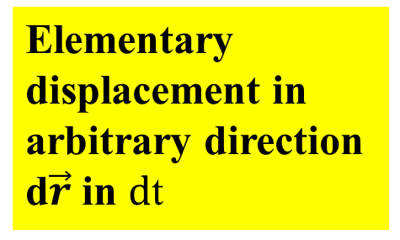
Velocity Vector
$$Z$$
Elementary displacement in arbitrary direction d$\vec{r}$ in $\text{d}\text{t}$
$r\sin{θ}dφ$ $\hat{φ}$
$$dr \hat{r}$$
d$\vec{r}$
$$θ$$
$$r$$
$$rdθ\hat{θ}$$
$$φ$$
$$Y$$
$$X$$
$$d\vec{r}=dr\hat{r}+rdθ\hat{θ}+r\sin{θ}dφ \hat{φ}$$
$$\vec{v}=\frac{d\vec{r}}{\text{d}t}=\frac{dr}{dt}\hat{r}+\frac{rdθ}{dt}\hat{ θ}+ \frac{r\sin{θ}dφ}{dt}\hat{φ}$$
$$\vec{v}=\dot{r}\hat{r}+r\dot{θ}\hat{θ}+r\sin{θ\dot{φ}}\hat{φ}$$

Slide 21
Done!
Well, We are done with the necessary
mathematical concepts!
Ok, Now in to Physics!

Slide 22

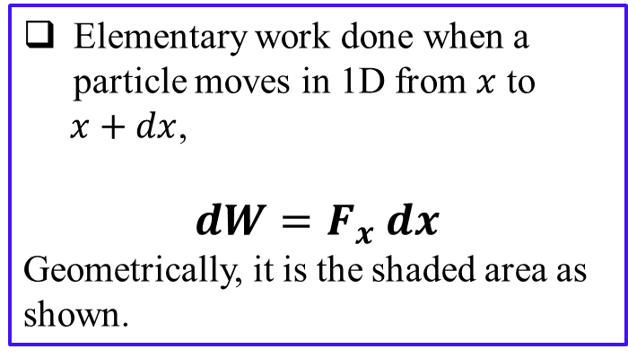



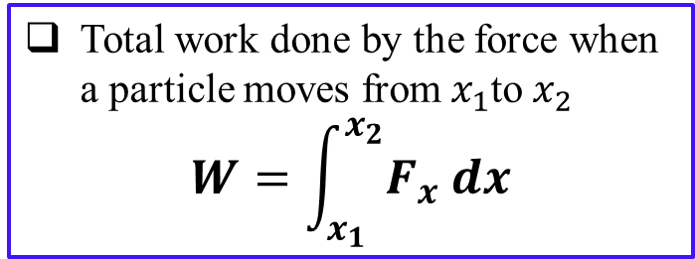

Work in 1D
Elementary work done when a particle moves in 1D from $x$ to
$x+dx$,
$dW=F_{x} dx$
Geometrically, it is the shaded area as shown.
$$F_{x}$$
Total work done by the force when a particle moves from${ x}_{1}$to $x_{2}$
$$W=\int_{x_{1}}^{x_{2}}{F_{x} dx}$$
$$x_{1}$$
$$x$$
$$x+dx$$
$$x_{2}$$
Geometrically it is the area between the curve and the $x−axis$

Slide 23


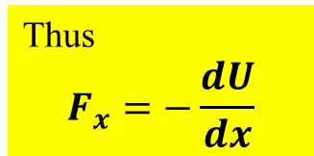

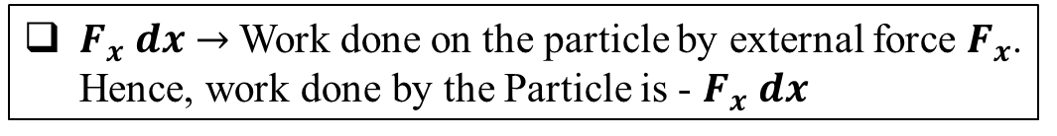
Work and potential energy
$dU→$ Change in potential energy of particle due to displacement $dx$ under the force $F_{x}$
$F_{x} dx→$Work done on the particle by external force $F_{x}$. Hence, work done by the Particle is - $F_{x} dx$
Work done by the particle = Change in its potential energy
(if no energy is lost by dissipation like heat, sound etc.)
$$−F_{x} dx=dU$$
Rule of partial differential
$$dU=\left(\frac{dU}{dx}\right)dx$$
Conversely if force is derivable from the scalar potential (known as conservative force) then,
Work done by the particle = Change in its potential energy
Thus
$$F_{x}=−\frac{dU}{dx}$$

Slide 24
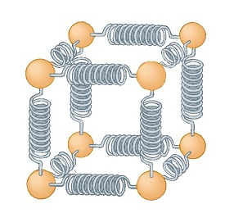
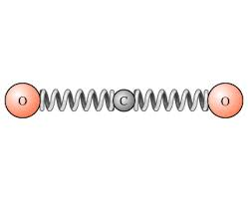

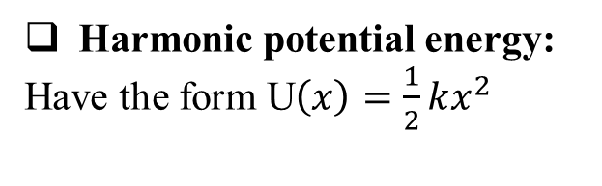


Example: Harmonic potential energy
U$\left(x\right)$
Harmonic potential energy:
Have the form U$\left(x\right)=\frac{1}{2}kx^{2}$
Why this particular potential energy?
Harmonic potential is very important in physics such as in the analysis of molecular vibrations, thermal properties of solids, etc.
U$\left(x\right)=\frac{1}{2}kx^{2}$
$$x$$
Spring model for Carbon dioxide
Atoms within crystal

Slide 25
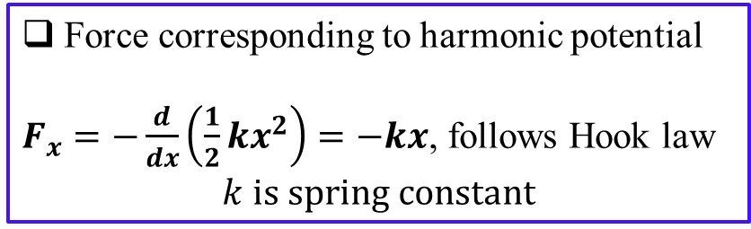
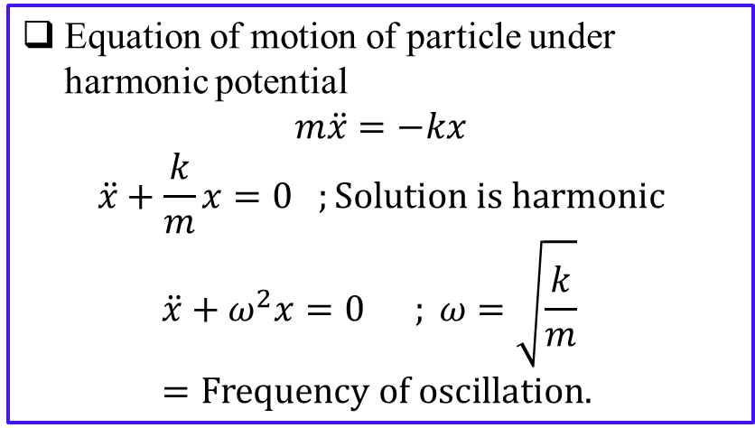
More on harmonic potential energy
Force corresponding to harmonic potential
$F_{x}=−\frac{d}{dx}\left(\frac{1}{2}kx^{2}\right)=−kx$, follows Hook law
$$k is spring constant$$
U$\left(x\right)$
U$\left(x\right)=\frac{1}{2}kx^{2}$
Equation of motion of particle under harmonic potential
$$m\ddot{x}=−kx$$
$$\ddot{x}+\frac{k}{m}x=0 ;Solution is harmonic$$
$$\ddot{x}+ω^{2}x=0 ; ω=\sqrt{\frac{k}{m}}=Frequency of oscillation.$$
$$x$$

Slide 26
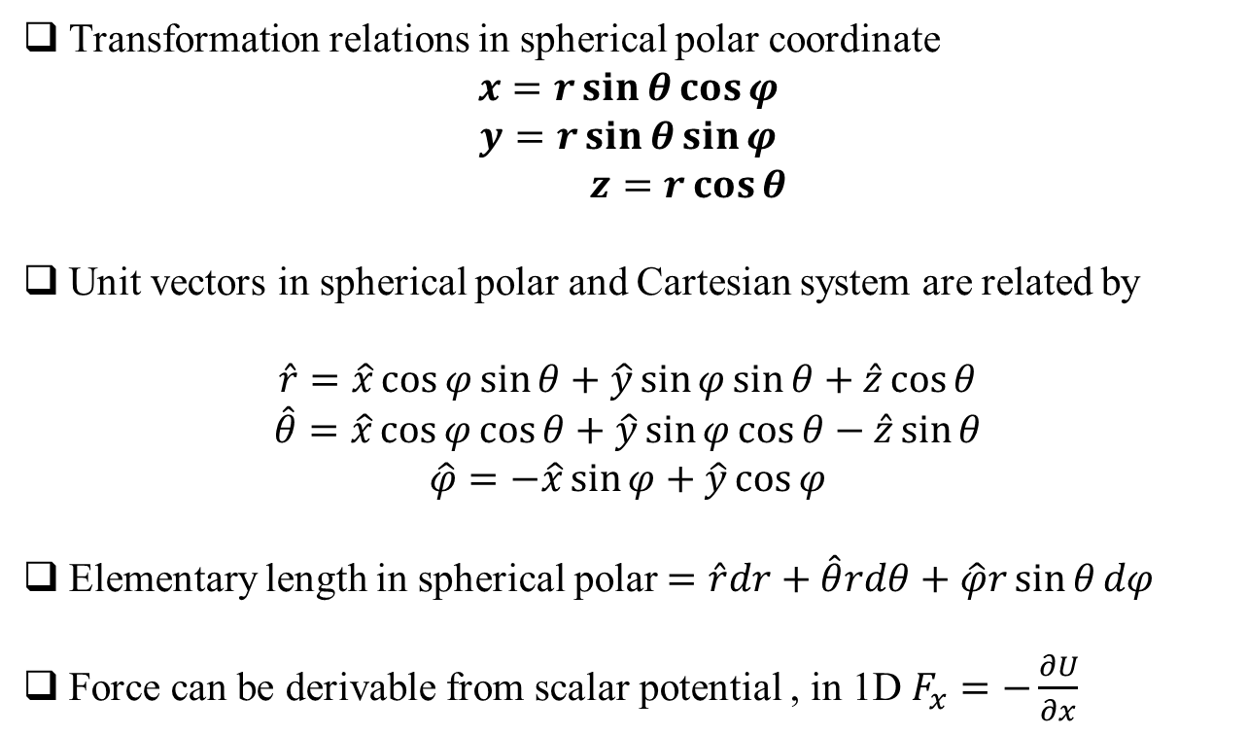
Summery
Transformation relations in spherical polar coordinate
$$x=r\sin{θ}\cos{φ}$$
$$y=r\sin{θ}\sin{φ}$$
$z=r\cos{θ}$
Unit vectors in spherical polar and Cartesian system are related by
$$\hat{r}=\hat{x}\cos{φ}sin{θ}+\hat{y}\sin{φ}sin{θ}+\hat{z}\cos{θ}$$
$$\hat{θ}=\hat{x}\cos{φ}cos{θ}+\hat{y}\sin{φ\cos{θ}}−\hat{z}\sin{θ}$$
$$\hat{φ}=−\hat{x}\sin{φ}+\hat{y}\cos{φ}$$
Elementary length in spherical polar $=\hat{r}dr+\hat{θ}rdθ+\hat{φ}r\sin{θ}dφ$
Force can be derivable from scalar potential , in 1D $F_{x}=−\frac{∂U}{∂x}$

Slide 27
Questions please

